Slide 1
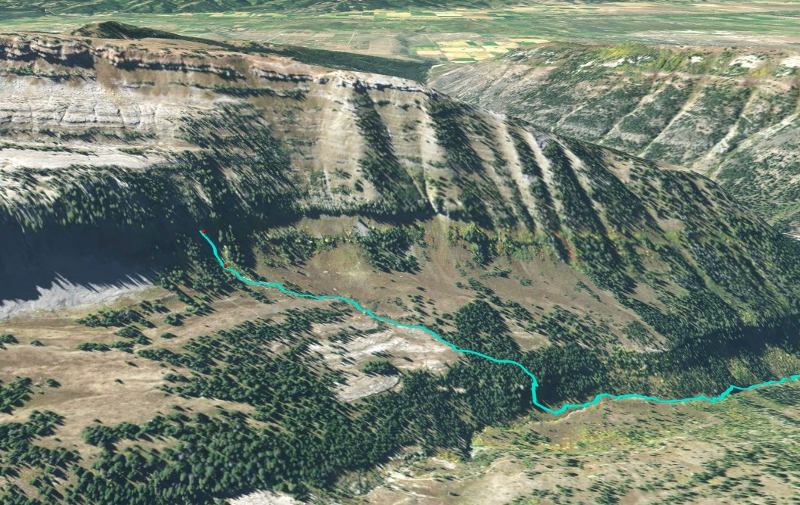

Slide 2
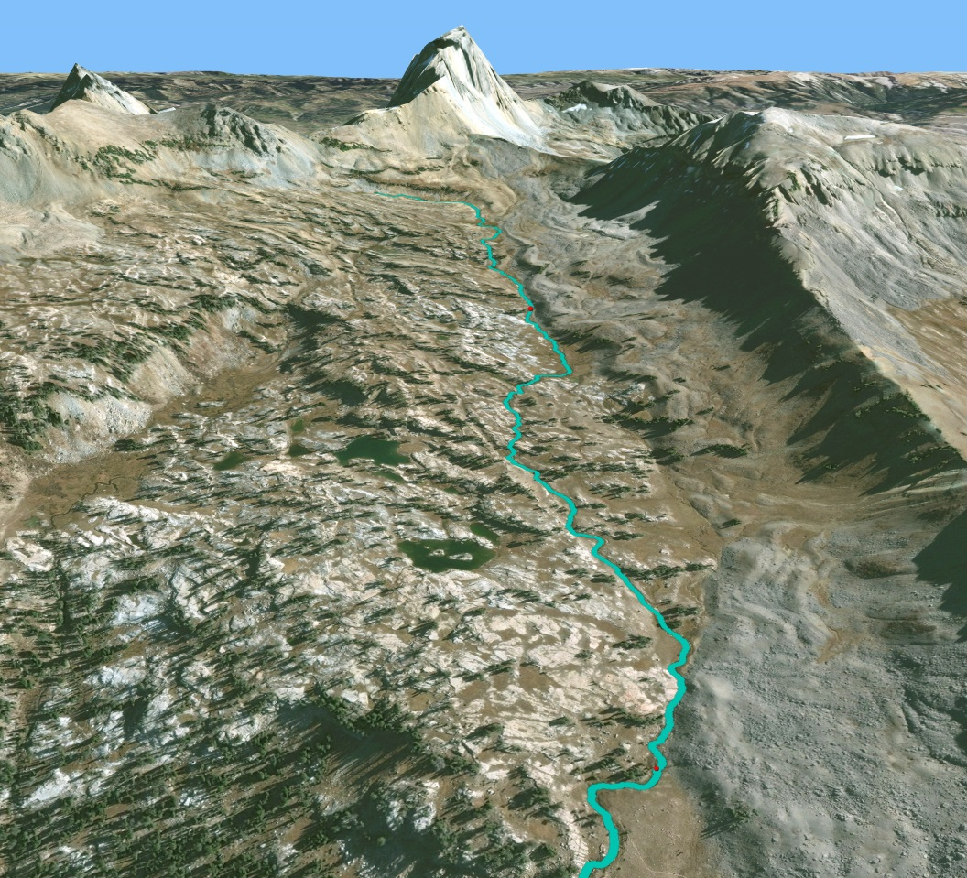

Slide 3
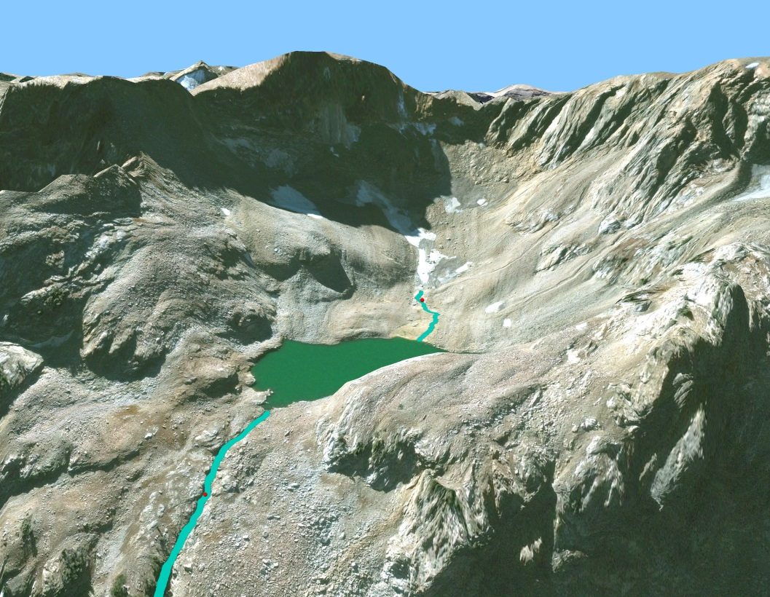

Slide 4
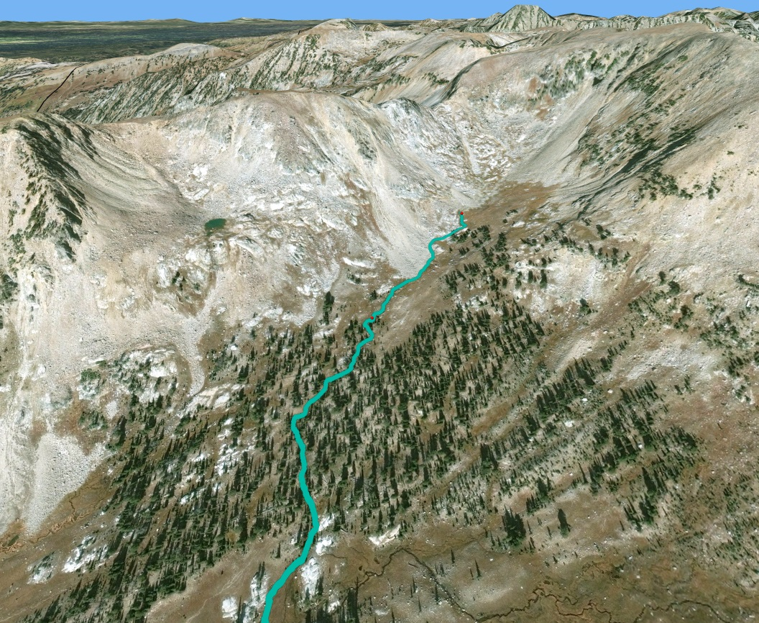

Slide 5
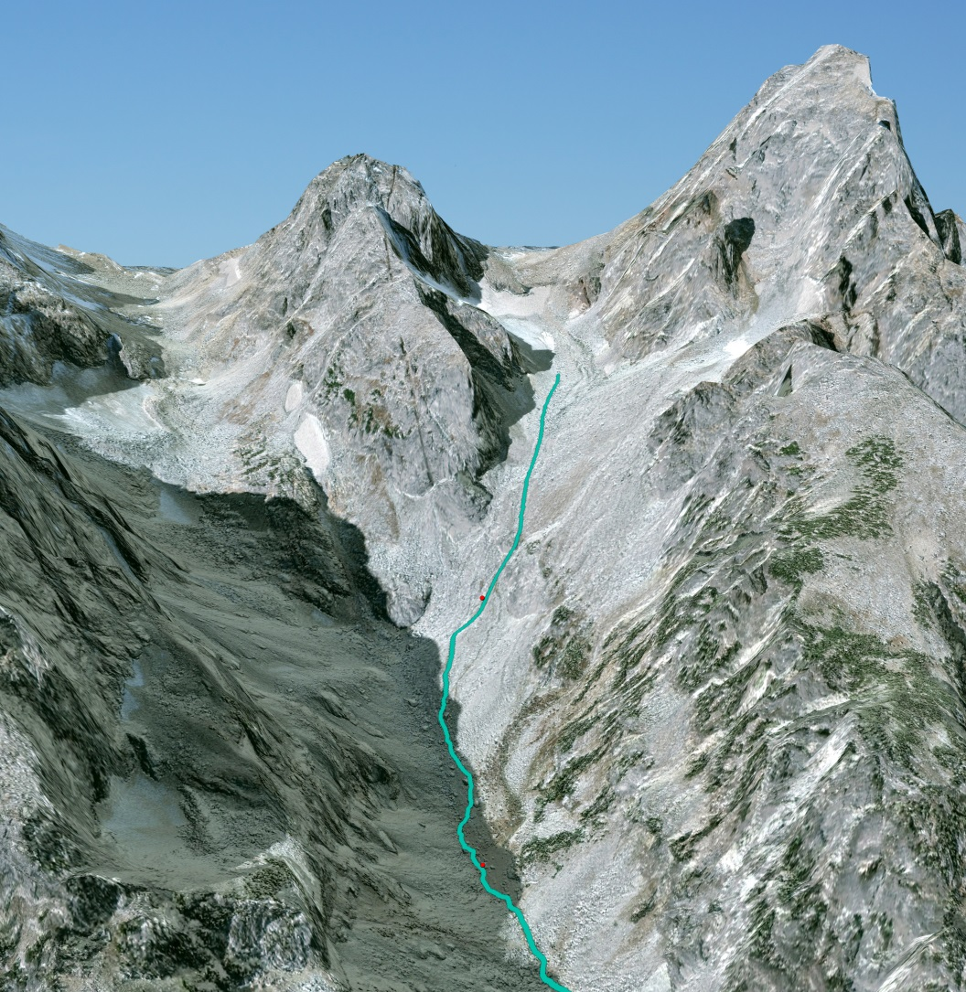

Slide 6
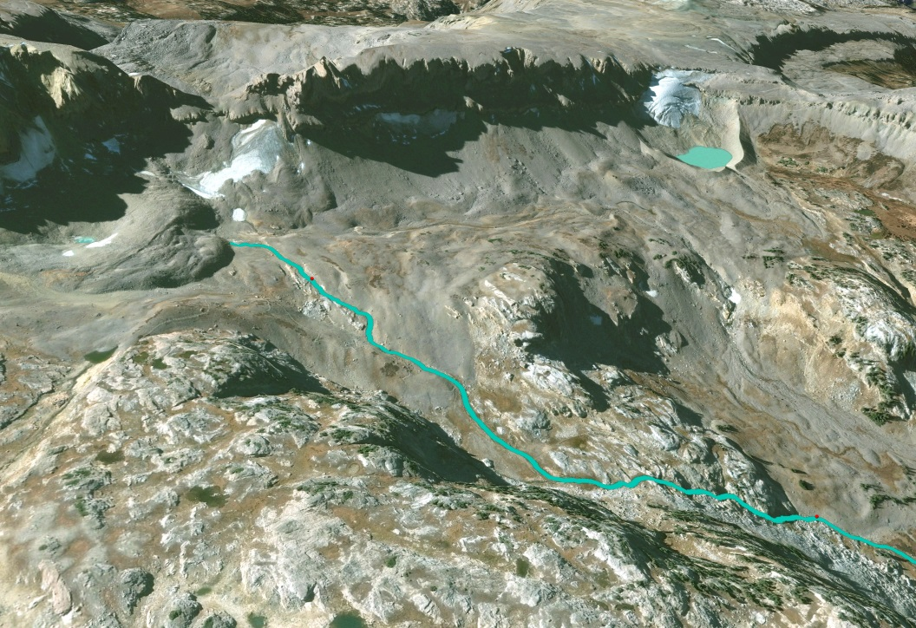

Slide 7
2015 only

Slide 14
Daily Temps

Slide 15
Wind Cave
Lower site with higher summer temps, as expected, but lower winter temps show groundwater influence.

Slide 16

Alaska Basin

Slide 17

Mica Lake
Lower site with higher average summer temps, as expected. Upper site with some high max temps late in Sept 2015 maybe due to low water levels. Lower temp ranges below the lake due to lake effect tempering temperatures.

Slide 18

North Fork Teton
Higher site with warmer summer temps than lower site, indicating possible groundwater influence at lower site.

Slide 19

Middle Teton Glacier
Lower site with higher summer temps, as expected.

Slide 20
South Cascade
Upper site with higher average summer temps. Hmmm… I don’t know what to say about this.

